Slide 1

Customer Segmentation Project
Virtual Internship
30-Aug-2022

Slide 2
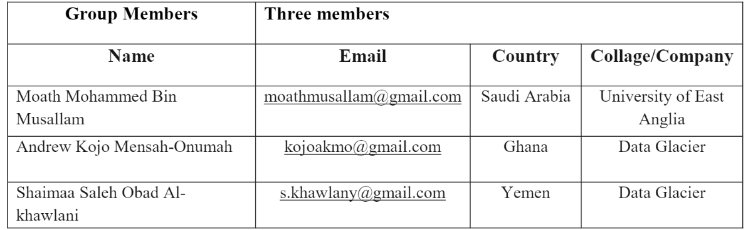
Group Information
Group Name: M.A.S
Specialization: Data Science
Submitted to: Data Glacier canvas platform
Internship Batch: LISUM10: 30

Slide 3
Link of the EDA file
https://github.com/kojomensahonums/Customer-segmentation-with-Data-Glacier/blob/master/Week10-EDA/Customer-Segmentation-Project-EDA.ipynb

Slide 4
Problem description
Most banks around the world have variant large customer base with different income levels, ages, characteristics, values and lifestyles. XYZ bank wants to increase the production and the satisfactions of all customers categories by roll out Christmas offers to their customers. But Bank does not want to roll out same offer to all customers instead they want to roll out personalized offer to particular set of customers. If they manually start understanding the category of customer then this will be not efficient and also, they will not be able to uncover the hidden pattern in the data (pattern which group certain kind of customer in one category).
Objectives:
To increase the production and the satisfactions of all customers categories by roll out Christmas offers to their customers.

Slide 5
Points to go through
Total data count :1000000
The main goal is the bank's customers and product from Different Aspects:
How many customers the bank have per (Country /Province / Gender /Age /
Channel used by the customer/ Customer type)?
What is the Total Gross income of the household per (Country/ Province/ Residence index/
Foreigner index/ Deceased index/ Customer type)?
What is the most used products in general?
What is the most channel used by the customer?
What bank products are used by people of different age brackets?
What are the popular products per city?
What bank products are used by people of different income brackets?
What are the least and most used products?
What are the popular products by gender?

Slide 6
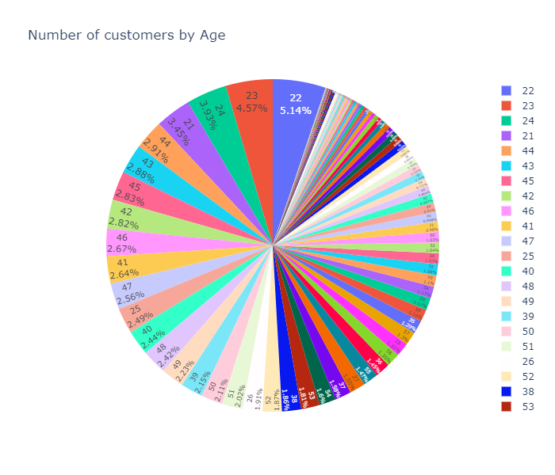
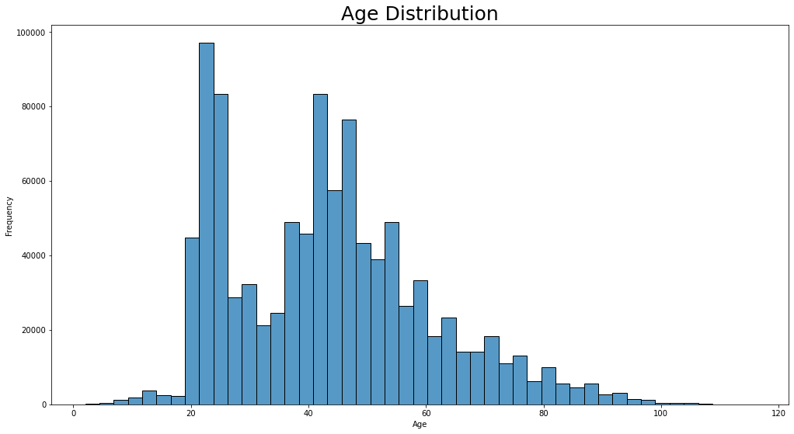
Customer age distribution
Since our data is about bank products, we should see who are our customer.
From the graph, we can see that observations customer age range varies between 20 to 70 but the most are in 20 to 22.
and the pie Char shows the customer age range varies between 20 to 100 but the most are in 20 to 22.

Slide 7
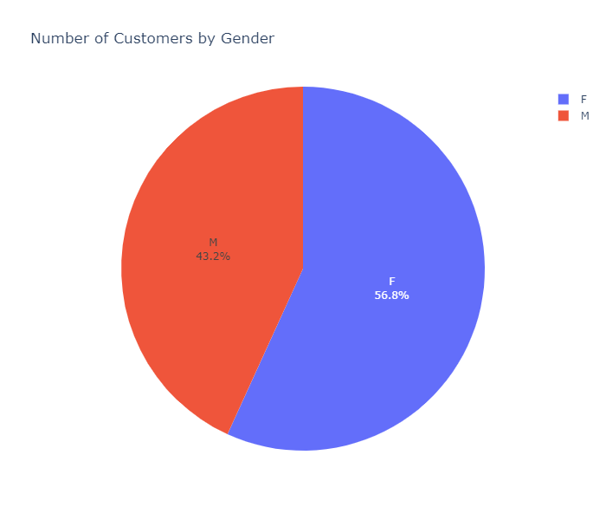
Customer per gender
As per the pie chart, the number of customer by gender shows the Female customers are more than Male.

Slide 8
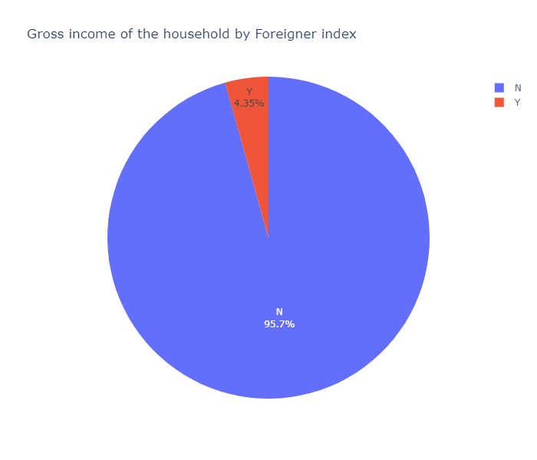
Customer citizenship distribution
The pie chart shows the number of Citizens and foreigners' customers.

Slide 9
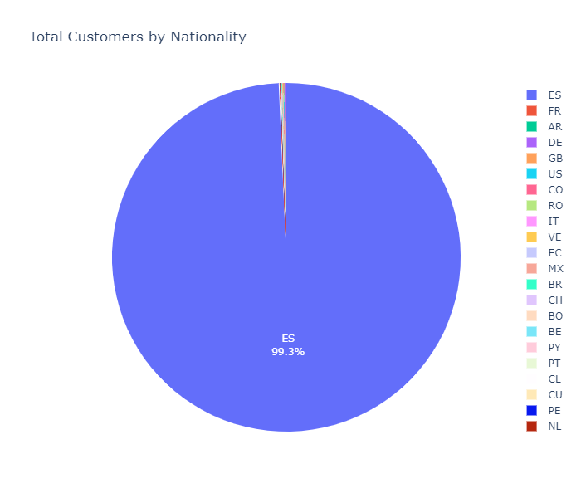
Customer by Nationality
As per the pie chart, the number of customer by Nationality shows the customers are from Spain.

Slide 10
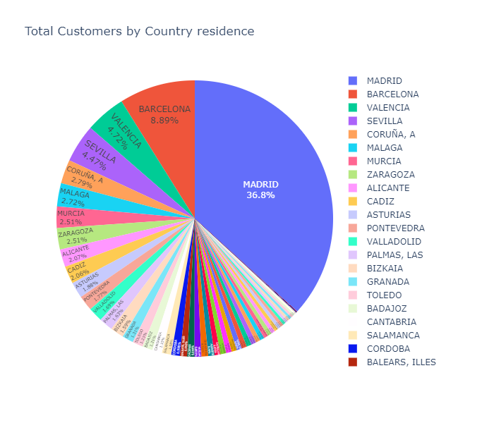
Customer by cities distribution
As per the pie chart, the number of customer by Cities shows the most customers are in Madrid then Barcelona.

Slide 11
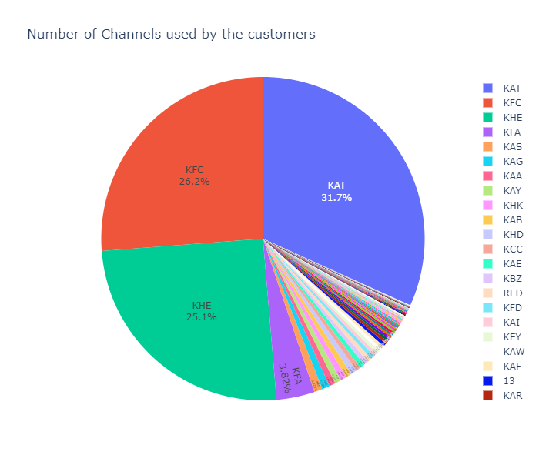
Number of Channels used by the customers
From the chart the most used channels are (KAT, KFC and KHE).

Slide 12
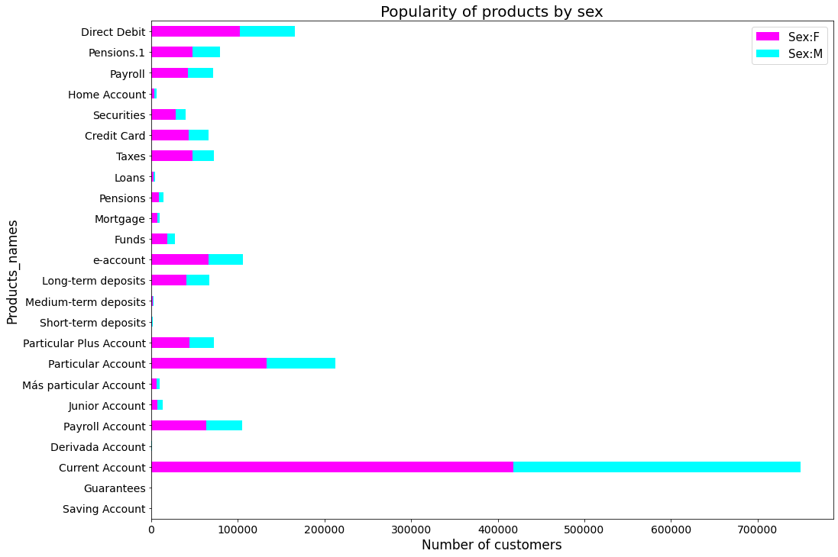
Products Analysis
The bank most products used was as follow:
Current Account: 749626 Particular Account: 212486 Direct Debit: 166275
The graph show the distribution of the products by gender

Slide 13
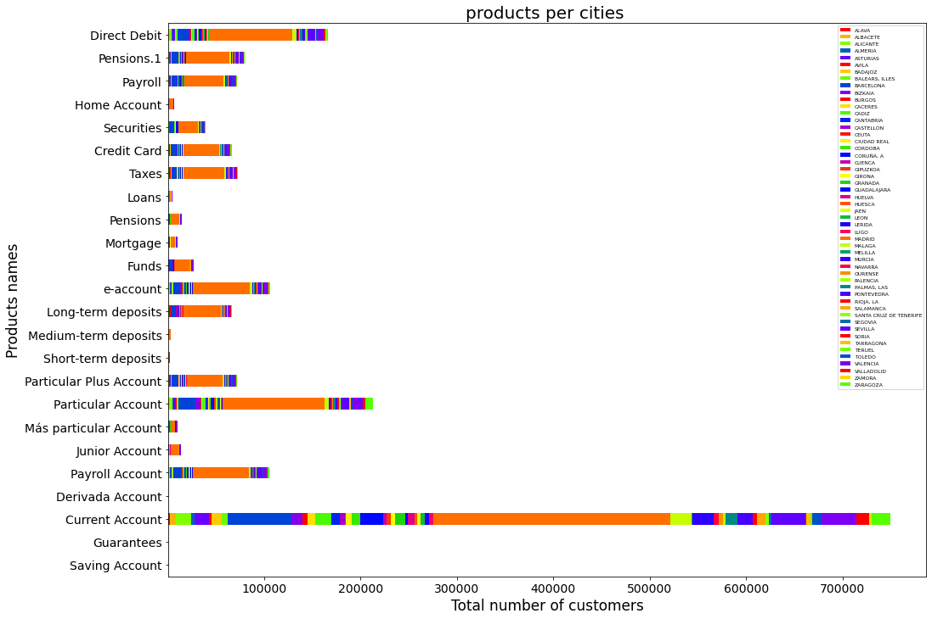
Products Analysis
The bank most products used per cities was as it’s shown in the graph.
However, The graph show the distribution of the products by cities, and the most city using bank products is Madrid the color code is orange.

Slide 14
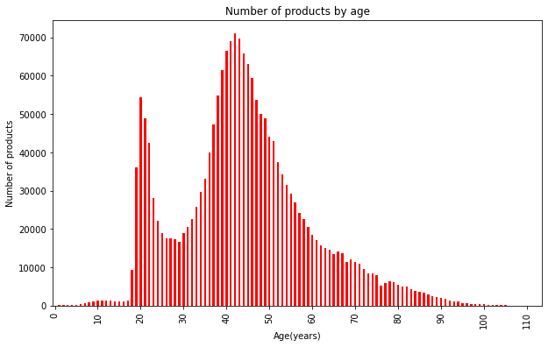
Products Analysis
The bank products used per age as it’s shown in the graph.
The graph show the distribution of the products by age, and the most people using bank products is youth and meddle age group of people.

Slide 15
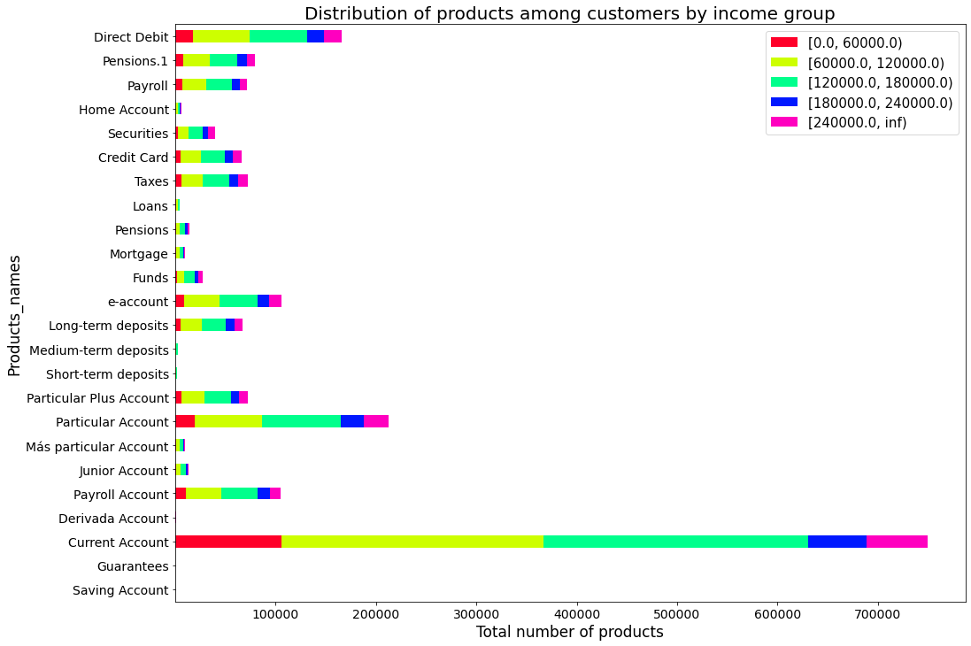
Products Analysis
The bank products used per age as it’s shown in the graph.
The graph show the distribution of the products by income class, and the most people using the bank product “current account”.

Slide 16
Conclusion
At the end from the above analysis, we summarize the following:-
Most of the customers and products used are in Spain
Madrid has the highest costomer numbers and product used.
Females are the most customer number in the bank in term of genders.
Regarding to the ages, all observations mentions that customer in twenties are most bank's customers.
The most account/product used is the Current Account.
The most channel used by customer is KAT channel.

Slide 17
Recommendations
1. According to the age insights it is highly recommended to focus on ages that is younger than and older than twenties ages.
2. Males has lower product usage than Females, so we recommend to give special offes for Males.
3. We can say that Spain is the only Country which uses bank's prosucts, the bank has to foucs on other countries.
4. As per the insights most of the customers are in Madrid then Berclona, the other Cities are very low so special offers has to proposed to these cities to increase the customer numbers.
5. the bank has to give spcial offers for the prodcuts rather than current account since it is the most used product.

Slide 18
Tech Recommendations
The technical recommendations will be to use the following methods. Since the data have no dependent value, unsupervised learning techniques should be applied.
The elbow method:
The elbow method uses the sum of squared distance (SSE) to choose an ideal value of k based on the distance between the data points and their assigned clusters
PCA:
Principal component analysis (PCA) is a widely used statistical technique for unsupervised dimension reduction. It is believed that it improves the clustering results in practice (noise reduction)
Clustering:
Clustering is the task of dividing data points into a number of groups such that data points in the same groups are more similar to other data points in the same group than those in other groups.

Slide 19
M.A.S
Thank You

